Slide 1


ENGINEERING EXPLORATION
.

Slide 2
Prepared for:
The Department of Engineering Exploration
Chaitanya Bharathi Institute of Technology, Hyderabad
Prepared by:
Nikhitha Tubati ------------------------------------------------------160120733012
Mohd Ameenuddin Ahmed --------------------------------------160120733024
Philip Godala---------------------------------------------------------160120733036
Sai Vishal Uppala ----------------------------------------------------160120733048
Vishnu Sathwik Rebally --------------------------------------------160120733060

Slide 3
ACKNOWLEDGEMENT
We would like to express our deepest appreciation to all those who provided us with the possibility to complete this project. Special gratitude to our project mentor, Smt. Isha Padhy ma’am whose contribution in stimulating suggestions and encouragement, helped us to coordinate our project especially in writing this report. Furthermore, we would also like to acknowledge with much appreciation the department of Engineering Exploration to give us this humble opportunity. A special thanks to our family members and friends for the support and encouragement they have given to us over the course.

Slide 4
ABSTRACT
Library Management System – Python Project
A College Library management is a project that manages and stores books information electronically according to student needs along with the student information. This helps both students and library managers to keep a constant track of all the books available in the library. It allows both the admin and the student to search for the desired book. It becomes necessary for colleges to continuously check the books issued and returned and even calculate fines. This task if carried out manually includes chances of mistakes. These errors are avoided by allowing the system to keep track of information such as issue date, last date to return the book and even fine information and thus there is no need to keep manual track of this information which avoids the chances of mistakes.
This project aims to create an interactive library management system using python as a base programming language, Tkinter library for graphical user interface and files for data management.

Slide 5
INTRODUCTION
The library management system is a project written in python programming language using Tkinter. This project is written to simulate the role of a librarian in a library. The features of this project are it can keep track of all the books available in the library. It has a very interactive and simple user interface GUI that both student and admin can use to receive or return books and admin to monitor the process and make sure everything goes correctly.
The code of this project is written in Python 3.9 using the Tkinter module for GUI and this project uses a text file(.txt) to store all the books available in the library and students can make changes to this file as it is regularly updated whenever a student needs a book or want to return a book. The admin can use this project to delete a particular book from the library and add any new books purchased to issue for the students.
This project contains 6 python files which are mainwindow.py, add_book.py, view_books.py, remove_book.py, issue_book.py, return_book.py and all of the information regarding the books are stored in the books.txt file.

Slide 6
Project aims:
The project aims and objectives that will be achieved after completion of this project are:
A database containing the list of all books in the library.
Facility to mark book either as available or issued.
Add various books to the library database.
To store the information regarding the author’s name and book id.
Facility to issue an available book to students.
To get the student id while the student borrows a book.
Facility to remove books from the system.
Facility to allow students to return the book to the library.

Slide 7
SYSTEM REQUIREMENTS:
Software Requirements:
Python 3.9 IDLE or PyCharm
Windows (7 or above) or Mac OS (10.11 or higher)
Installed Tkinter library
Hardware Requirements:
Processor: Intel I3 or above
Disk space: 1 GB or more

Slide 8
Existing system vs Proposed system:
Early days Libraries are managed manually. It required a lot of time to record or retrieve the details. The employees who have to record the details must perform their job very carefully. Even a small mistake would create a lot of problems. Security of information is very less. Report generations of all the information are a very tough task.
Maintenance of the Library catalogue and arrangement of the books to the catalogue is a very complex task. In addition to its maintenance of member details, issue dates and return dates etc. manually is a complex task.
All the operations must be performed perfectly for the maintenance of the library without any degradation which may finally fail the entire system.

Slide 9
To solve the inconveniences as mentioned in the existing system, a Library Management System is proposed. The proposed system contains the following features:
A single file-based management system that holds the record of the book id, book name, author and whether the book is available or has been issued.
A function to add new books to the library database.
A function to remove books from the database.
A function that issues the required book to a student depending on its availability.
A function that manages the return of borrowed books from the students.
Pop up errors if there is any fallacy in book id or student id

Slide 10
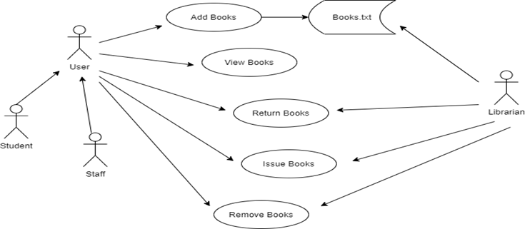
Methodology:

Slide 11
The above level diagram is the functioning of the Library Management System in a very lucid way. The user can either be a staff or a student. The system will provide view functionality to view different books available in the library. Further, the library staff person can add/update the resources. The users of the system can request to issue/return the book for which they have to follow certain criteria.
Description of the Files:
mainwindow.py – which does function call to all other python files
add_book.py – To add the book
view_books.py – To view the list of books in the library
remove_book.py – To remove a book from library
issue_book.py – To issue a book from library
return_book.py – To return a book to the library
books.txt – To store the data related to books in the library

Slide 12
Source Code
Library Management System (E.E Project)
view_books.py file:
from tkinter import *
def viewbooks():
global root4
root4=Tk()
root4.geometry("700x780")
root4.minsize(700,780)
root4.title("View Books")
heading=Label(root4,text="BOOKS DETAILS",bg='black',fg="yellow",font="gotham 20 bold",borderwidth=10,relief=SUNKEN,padx=10,pady=4)
heading.pack(pady=5,fill=X)

Slide 13
add_book.py file:
from tkinter import *
from tkinter import messagebox
def bookadd():
global bookinfo1, bookinfo2, bookinfo3, bookinfo4, root5
def addbook():
book_id = bookinfo1.get()
title = bookinfo2.get()
author = bookinfo3.get()
status = bookinfo4.get()
with open('books.txt', 'a') as f:
f.write(f"\n{book_id}: {{TITLE: {title}, AUTHOR: {author}, STATUS: {status} }}")
messagebox.showinfo('Success',"Book added successfully")
root5.destroy()
return

Slide 14
main_frame=Frame(root4,height=700,width=780,borderwidth=8,relief=RIDGE,bg="grey",padx=8)
main_frame.pack(side=LEFT,anchor="nw",fill=X and Y)
Label(main_frame,text="book id : {book details}", font="cambria 13 bold",pady=5,bg="grey").pack(anchor="nw")
with open("books.txt", "r") as f:
data=f.read()
data=data.split('\n')
print(data)
for i in data:
Label(main_frame,text=f"{i}",font="times 12",bg="grey").pack(anchor="nw")
root4.mainloop()

Slide 15
root5=Tk()
root5.geometry("560x490")
root5.minsize(560,490)
root5.title("Library Management System")
Label(root5,text="ADD BOOK",font=("times",28,"bold"),fg="yellow",bg="black",borderwidth=12,relief=SUNKEN).pack(side=TOP,fill=X)
Label(root5,text=" Enter the following details ",fg="black").pack(pady=5)
labelframe = Frame(root5,height=800,width=600,bg='black')
labelframe.place(relx=0.1,rely=0.3,relwidth=0.8,relheight=0.45)
lb1 = Label(labelframe,text='Book ID : ',bg='black',fg='white')
lb1.place(relx=0.05,rely=0.2,relheight=0.08)
bookinfo1 = Entry(labelframe)
bookinfo1.place(relx=0.3,rely=0.2,relwidth=0.62,relheight=0.08)
lb2 = Label(labelframe,text='Title : ',bg='black',fg='white')
lb2.place(relx=0.05,rely=0.35,relheight=0.08)

Slide 16
bookinfo2 = Entry(labelframe)
bookinfo2.place(relx=0.3,rely=0.35,relwidth=0.62,relheight=0.08)
lb3 = Label(labelframe,text='Author : ',bg='black',fg='white')
lb3.place(relx=0.05,rely=0.50,relheight=0.08)
bookinfo3 = Entry(labelframe)
bookinfo3.place(relx=0.3,rely=0.50,relwidth=0.62,relheight=0.08)
lb4 = Label(labelframe,text='Status(avail/issued) : ',bg='black',fg='white')
lb4.place(relx=0.05,rely=0.65,relheight=0.08)
bookinfo4 = Entry(labelframe)
bookinfo4.place(relx=0.3,rely=0.65,relwidth=0.62,relheight=0.08)
Submit = Button(labelframe,text='Submit',font=("times 11 bold"),command=addbook)
Submit.place(relx=0.3,rely=0.83,relwidth=0.18,relheight=0.15)
Quit = Button(labelframe,text='Quit',font=("times 11 bold"),command=root5.destroy)
Quit.place(relx=0.53,rely=0.83,relwidth=0.18,relheight=0.15)
root5.mainloop()

Slide 17
remove_book.py file: from tkinter import *
from tkinter import messagebox
def bookremove():
global book_id, root2
def removebook():
bid=book_id.get()
if bid:
with open("books.txt", "r") as f_old:
data=f_old.read()
with open("books.txt", "w") as f_new:
data=data.split('\n')
for j in data:
if bid in j:
pass
else:
f_new.write(f"{j}\n")
messagebox.showinfo("Book Removed","Book removed from data.")

Slide 18
else:
messagebox.showerror("Invalid ID","Please enter correct book id.")
root2.destroy()
return
root2=Tk()
root2.geometry("455x300")
root2.maxsize(455,300)
root2.minsize(455,300)
root2.title("Remove Book")
heading=Label(root2,text="REMOVE BOOK",bg='black',fg="yellow",font="gotham 28 bold",borderwidth=10,relief=SUNKEN,padx=75,pady=8)
heading.grid(row=0,column=0)
f1=Frame(root2,height=10,width=700,bg="black",pady=30,padx=80)

Slide 19
f1.grid(row=3,column=0,pady=5)
Label(f1,text="Enter book id:",bg="black",fg="white",font="comicsanms 11",padx=10,pady=10).grid(row=3,column=1)
book_id=Entry(f1)
book_id.grid(row=3,column=2)
Button(f1,text="Exit",font=("times 11 bold"),command=root2.destroy,padx=8).grid(row=6,column=2,padx=10,pady=10)
Button(f1,text="Submit",font=("times 11 bold"),command=removebook).grid(row=5,column=2,padx=10,pady=10)
root2.mainloop()

Slide 20
issue_book.py file:
from tkinter import *
from tkinter import messagebox
def bookissue():
global book_id, student_id, root3
def issuebook():
p=book_id.get()
q=student_id.get()
if p and q:
with open("books.txt", "r") as f:
data=f.read()
if p in data:
messagebox.showinfo("Issues","Book successfully issued to student.")
else:
messagebox.showerror("Invalid ID","Please enter a valid book ID")

Slide 21
else:
messagebox.showerror("Invalid ID","Please enter a valid ID")
root3.destroy()
return
root3=Tk()
root3.geometry("440x400")
root3.maxsize(440,400)
root3.minsize(440,400)
root3.title("Issue Book")
heading=Label(root3,text=" ISSUE BOOK ",bg='black',fg='yellow',font="gotham 28 bold",borderwidth=10,relief=SUNKEN,padx=80,pady=8)
heading.grid(row=0,column=0)
f1=Frame(root3,height=600,width=680,bg="black",pady=50,padx=80)
f1.grid(row=3,column=0,pady=5)

Slide 22
Label(f1,text="Enter book id:",bg="black",fg="white",font="comicsanms 11",padx=10,pady=10).grid(row=3,column=1)
book_id=Entry(f1)
book_id.grid(row=3,column=2)
Label(f1,text="Enter student id:",bg="black",fg="white",font="comicsanms
11",padx=10,pady=10).grid(row=4,column=1)
student_id=Entry(f1)
student_id.grid(row=4,column=2)
Button(f1,text="Exit",font=("times 11 bold"),command=root3.destroy,padx=8).grid(row=6,column=2,padx=10,pady=10)
Button(f1,text="Submit",font=("times 11 bold"),command=issuebook).grid(row=5,column=2,padx=10,pady=10)
root3.mainloop()

Slide 23
return_book.py file: from tkinter import *
from tkinter import messagebox
def bookreturn():
global book_id, student_id, root1
def returnbook():
p=book_id.get()
q=student_id.get()
if p and q:
messagebox.showinfo("Returns","Book returned successfully. Thank you!")
else:
messagebox.showerror("Invalid ID","Please enter a valid ID")
root1.destroy()
return

Slide 24
root1=Tk()
root1.geometry("455x400")
root1.maxsize(455,400)
root1.minsize(455,400)
root1.title("Return Book")
heading=Label(root1,text="RETURN BOOK",bg='black',fg='yellow',font="gotham 28 bold",borderwidth=10,relief=SUNKEN,padx=75,pady=8)
heading.grid(row=0,column=0)
f1=Frame(root1,height=600,width=700,bg="black",pady=50,padx=80)
f1.grid(row=3,column=0,pady=5)
Label(f1,text="Enter book id:",bg="black",fg="white",font="comicsanms 11",padx=10,pady=10).grid(row=3,column=1)
book_id=Entry(f1)
book_id.grid(row=3,column=2)
Label(f1,text="Enter student id:",bg="black",fg="white",font="comicsanms 11",padx=10,pady=10).grid(row=4,column=1)
student_id=Entry(f1)

Slide 25
student_id.grid(row=4,column=2)
Button(f1,text="Exit",font=("times 11 bold"),command=root1.destroy,padx=8).grid(row=6,column=2,padx=10,pady=10)
Button(f1,text="Submit",font=("times 11 bold"),command=returnbook).grid(row=5,column=2,padx=10,pady=10)
root1.mainloop()

Slide 26
mainwindow.py file:
from tkinter import *
def view():
from view_books import viewbooks
viewbooks()
def add():
from add_book import bookadd
bookadd()
def remove():
from remove_book import bookremove
bookremove()
def issue():
from issue_book import bookissue
bookissue()
def returns():
from return_book import bookreturn
bookreturn()

Slide 27
root=Tk()
root.geometry("700x600")
root.minsize(655,500)
root.title("Library Management System-Dashboard")
bg=PhotoImage(file="bird-library-livestream.png")
Label(root,image=bg).place(x=0,y=0)
Label(root,text="LIBRARY MANAGEMENT SYSTEM",font=("times",28,"bold"),bg="black",fg="yellow",relief=RIDGE,borderwidth=8).pack(side=TOP,fill=X)
Label(root,text=" WELCOME TO THE LIBRARY ",font=("avenir",18,"bold"),fg="blue",bg="lightblue").pack(side=TOP,padx=10,pady=15)
Label(root,text=" Pick an option to continue ",bg="grey",fg="black").pack(pady=5)

Slide 28
Button(root,text="View Books",padx=90,pady=10,command=view,font=("gotham",14),bg="black",fg="lightblue").pack(padx=2,pady=4)
Button(root,text="Add Book",padx=100,pady=10,command=add,font=("gotham",14),bg="black",fg="lightblue").pack(padx=2,pady=4)
Button(root,text="Remove Book",padx=80,pady=10,command=remove,font=("gotham",14),bg="black",fg="lightblue").pack(padx=2,pady=4)
Button(root,text="Issue Book to student",padx=50,pady=10,command=issue,font=("gotham",14),bg="black",fg="lightblue").pack(padx=2,pady=4)
Button(root,text="Return Book",padx=90,pady=10,command=returns,font=("gotham",14),bg="black",fg="lightblue").pack(padx=2,pady=4)
root.mainloop()

Slide 29
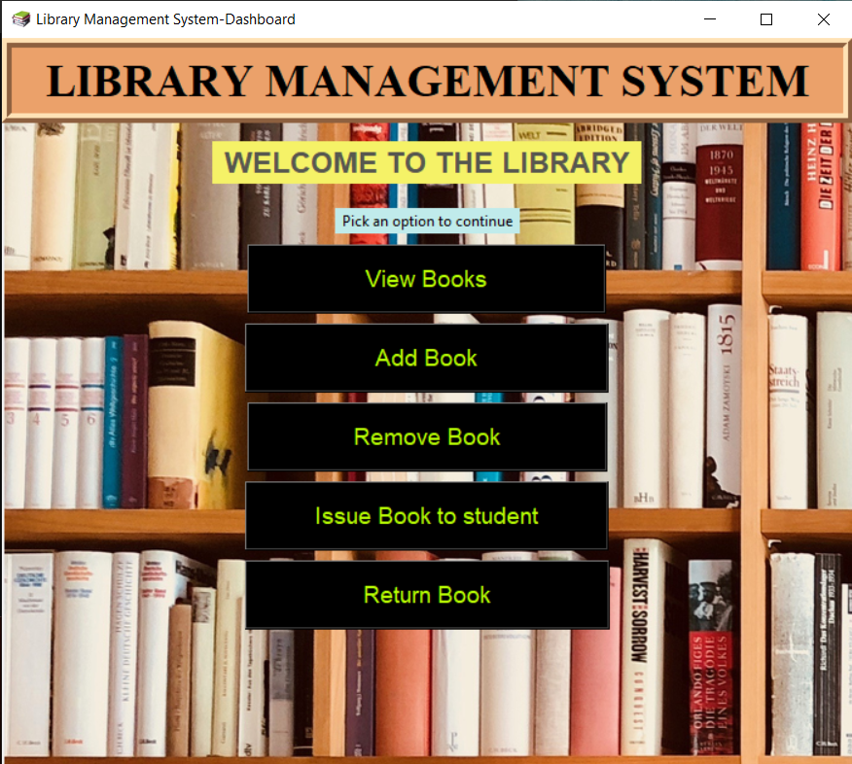
SCREENSHOTS OF THE PROJECT:
Main window:

Slide 30
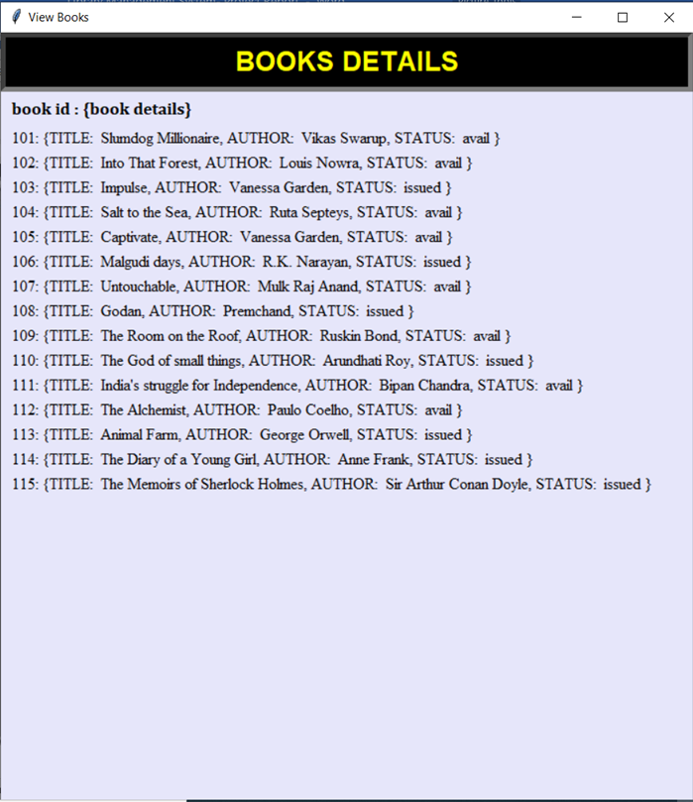
View books window:

Slide 31
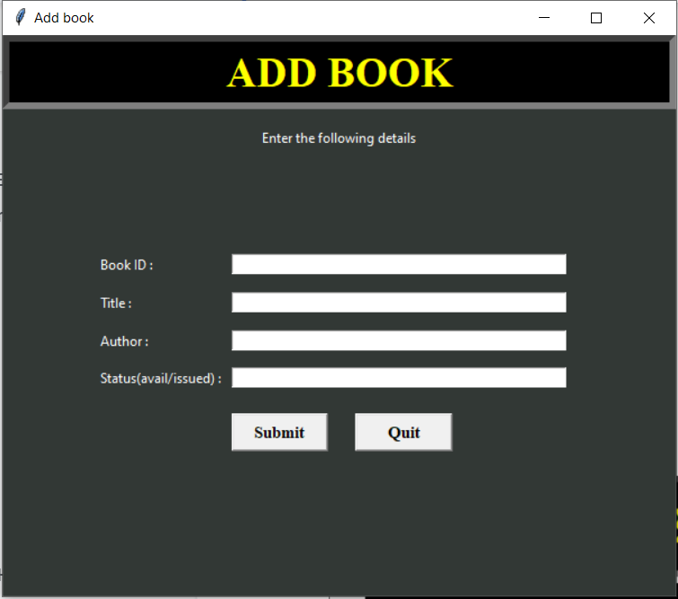
Add book window:

Slide 32
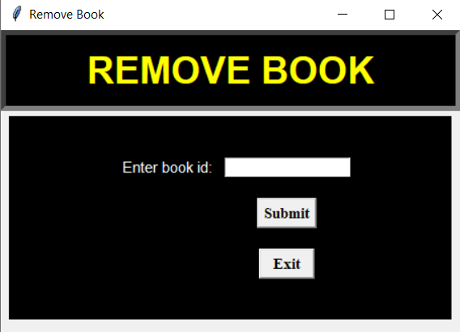
Remove book window:

Slide 33
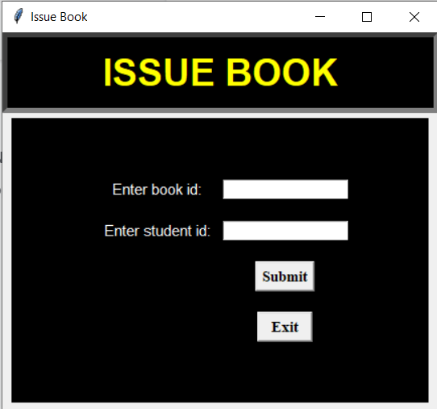
Issue book window:

Slide 34
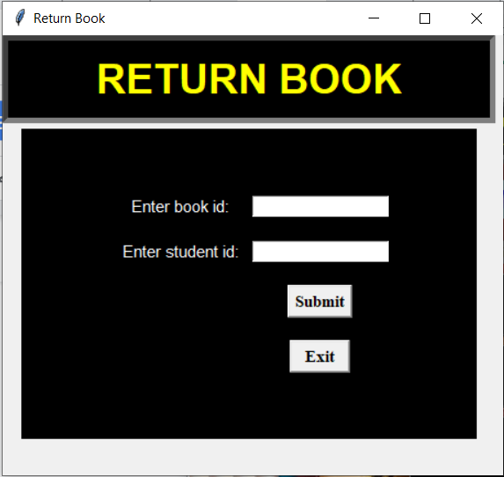
Return book window:

Slide 35
FUTURE SCOPE:
Personal Customization
Student Borrow System
User friendly and aesthetic user interface
Shifting the database to cloud
E-book borrowing section

Slide 36
REPORT AND ANALYSIS:
The above model of the Library Management System makes use of various modules to function as a system with integrity. In such programs, the extent of integration of various modules is a parameter defining the susceptibility of the whole system. However, the above system was observed to be versatile and the modules were integrating without any concerns, making the program run smoothly and perform various executions without any glitches. The handover of command from one module to the other when a desired function was called happened to be errorless and smoothly executed. The add books button which opens a window prompt to add the books to the database stores the data in a file in a dictionary format with the book id as the key. The issue book and return book functions throw an error when an incorrect book or student id is entered. The issue book button opens a prompt that asks the book and student id and issues the book only if it is marked as available in the database. The subtle use of message boxes makes the system more user friendly and easy to use. Although major improvements can be implemented to this system there is no hesitancy to conclude that the system is operable, user friendly and fulfils the objectives of this project.
Hereby we conclude that the Library Management System was able to accomplish all of its prerequisites successfully and also has the potential to make the process of library management computerised, relieving the workload from a librarian.

